Slide 1
UCLA CS97 Discussion 1B/1C
Week 3

Slide 2
Feedback Survey for our Discussion
Let us know what is helping you the most, or what is not so useful.
Be as honest as you want! Its anonymous!
https://forms.gle/FYpCKK15N2uyszgX6

Slide 3
LISP

Slide 4
LISP History and Why do We Care?
LISP was created in the late 1950s, 2nd oldest high-level programming language
LISP is a functional programming language, and was commonly used in a lot of AI research (before ML/Deep Learning became cool)
Why do we care now though?
Many Emacs functions are written in LISP
We can then use LISP to add/modify functions to Emacs
Similar to how people add extensions to Chrome/VSCode/etc to enhance their development experience

Slide 5
LISP Basics
Everything is a list structure, and there is a LOT of parentheses
So because everything is represented with a list, using a function is evaluated almost always the same way
; Semicolon is a comment
; Call (yourFunction arg1 arg2)
(+ 1 2) ; = 3
(* 2 3) ; = 6

Slide 6
LISP Conditionals (If statements)
Like in C++, you can have a "if-then" or an "if-then-else" statement
Keep note of the parenthesis's placement
;If-Then statement
(if (> 3 5) ; if-part
(message "3 is greater than 5")) ; then-part
;If-Then-Else statement
(if (> 3 5) ; if-part
(message "3 is greater than 5") ; then-part
(message "3 is NOT greater than 5")) ; else-part

Slide 7
Conditional Operators
https://www.tutorialspoint.com/lisp/lisp_operators.htm

Slide 8
LISP Functions
Can write your own functions with the syntax below!
;Define a function
;(defun function-name (arguments…)
; function-body…)
;Example Definition
(defun multiply-by-seven (number)
(* 7 number))
;Example Usage
(multiply-by-seven 5) ; = 35

Slide 9
Variables – Let/Set
Let
Define a local scope, and variables within that scope
;Example Usage
(let ((x 1)) ; x is now 1
(- x 2)) ; result is -1
Setq
Sets a variable value within the existing scope. Can update a variable value
;Example Usage
(setq x 1) ; x is now 1
(+ x 2) ; result is 3

Slide 10
Message (Printing in Emacs LISP)
Prints a string to stdout
Can provide variable arguments to insert into string
;Example Usage
(message "print this") ;output = "print this"
(message "print %s" string) ;output = "print string"
(message "print %d %d" 1 2) ;output = "print 1 2"

Slide 11
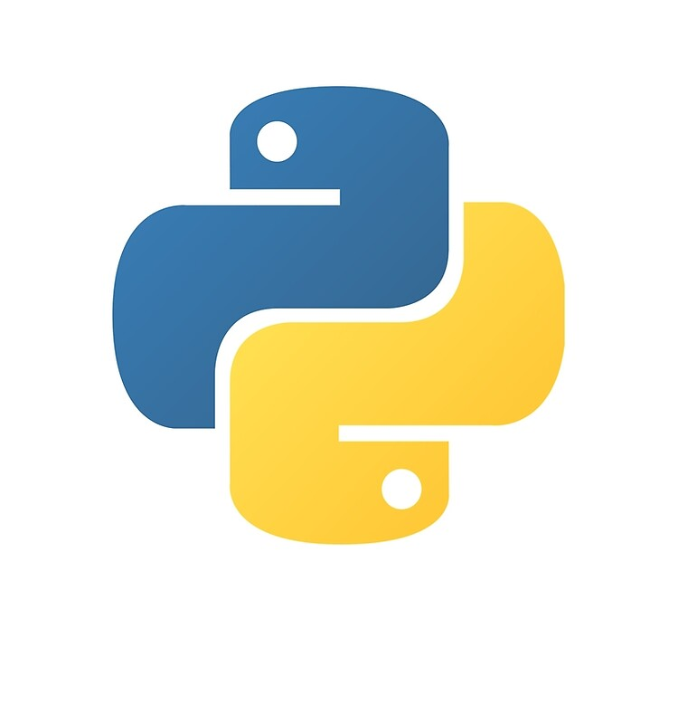
Python

Slide 12
Python History
Developed Guido van Rossum in the Netherlands
Guido was named BDFL or Benevolent Dictator For Life of Python
Has since helped shape and lead Python’s development
Python was named due to Guido being a fan of Monty Python’s Flying Circus (A British Comedy Show)
There is a “Zen of Python” to describe the language philosophy
Big focus on readability

Slide 13
Why is Python So Popular?
Python is accessible. Code is very readable and easy to write
Language features like dynamic typing and indentation help
Many powerful libraries and tools
Data science, Web Dev, etc.
Good developer support and active community involvement in open-source development

Slide 14
Note on Python Versions
Python3 is the current version (specifically 3.9.1) and nearly all new Python development is done with Python3
Python2 was popular as well, but became End-of-Life at the start of 2020.
There is still plenty of now “legacy” applications still running Python2
We will use Python3, and that does add additional features
Access with python3 from command-line

Slide 15
Python Coding Basics
Python in an interpreted language – no compilers
Python is dynamically typed
You do not have to declare the type of your variable, and there is no compiler to check for errors related to that (type checking)
Offer goods flexibility, but can lead to potential bugs and unsafe code in the long-term
Typical uses
Prototyping and Scripting
Research – ML, Data Science
Leetcode
Some web-related code (Django/Flask)
Notes:
# Declared variables automatically infer types
x = 1
# Python is dynamically typed: variables can be re-assigned
# to a value of a different type
x = "Aa"

Slide 16
Python Examples

Slide 17
Data Types – Mutability and Immutability
Some immutable types
Int
Float
Bool
Tuple
Str
Some mutable types
List
Dict
Set
NOTE – Python is dynamically typed. So you do not need to declare these types when you create a variable
Notes:
# Immutable types cannot be modified after creation
answer_to_life = 42 # int
pi = 3.14159 # float
is_tired = True # bool
greeting = "hello" # str
directions = ('N', 'S', 'E', 'W') # tuple
# Mutable types can be modified after creation
words = [3, "blind", "mice"] # list
fruits = {1: "apple", 2: "banana"} # dict
letters = set(['a', 'b', 'c']) # set
# Lists, dictionaries, and sets can be heterogeneous,
# a.k.a have elements of different types

Slide 18
Printing
Print() function
Print(‘hello_world’)
Multiple ways to print variables from print function.
My preferred way is to use the f-string (only in Python 3.6+)
Print(f “{var1} {var2}”)
Other ways include:
String concatenation (+ sign)
.format()
% identifiers like in C

Slide 19
Conditionals
Have access to typical operators from C
<, <=, >, >=, ==, !=
And/Or/Not are just spelled out
if cond1 and cond2
if cond3 or cond4
if not (cond5)
Can run simplified checks to see if values are in list/set
if val in list
If substring in bigger_string
Notes:
# Booleans are spelled out: and, or, not
True and False
True or False
not False
# Other comparators from C should look familiar
1 < 2
2 > 1
1 <= 2
1 >= 1
1 != 2
""" If Statements """
rainy = False
today = "Saturday"
if (today == "Saturday" or today == "Sunday") and not rainy:
print("Go to the beach")
elif not rainy:
print("Go to class")
else:
print("Stay inside")

Slide 20
is vs ==
is compares memory addresses
== invokes the obj._eq_ method
Primarily used for value comparisons
“is None” is preferred over “== None” if the goal is to test for None
Notes:
# Use == for value equality
# Use "is" for object equality (compares in memory)
x = [1]
y = [2]
z = [1]
print(x == z)
print(x == y)
print(x is x)
print(x is z)

Slide 21
Lists
Python lists act like C++ Vectors
They track their own size
You can add/remove elements, and the list will resize as necessary
You can access elements like in C++
my_list[index]
Notes:
""" Lists """
my_list = [] # Declare empty list
l = [1, 2, "red", "green"] # Declare (heterogeneous) list
len(l) # List length (len() works on other sequences too)
"red" in l # Check if list contains value
# Modifying Lists
l.remove("green") # Remove first occurence of "green"
l.append("blue") # Append "blue"
my_list.append("yellow") # Append "yellow"
my_list.extend(l) # Merge two lists (can also use +=)
print(f”{l}”)
print(f”{my_list}”)

Slide 22
Range and For-in
Range is a function to generate an immutable sequence type, useful for loops.
Can also access contents of a list/set/dict directly

Slide 23
Functions

Slide 24
Indentation and Whitespace
Python is very sensitive to indentation and whitespace
Each code block needs to be indented to be grouped together
The python interpreter will assign scope that way
Try to only use tabs or spaces, a mixture of both can mess up the grouping
Statements the begin a new block (if, loops, functions) need a :
Note – no semicolons required!

Slide 25
Naming Convention
"""
UpperCamelCase for class names
CAPITALIZED_WITH_UNDERSCORES for script level constants
snake_case for everything else
"""
CONST_VAR = 3
def functions_snake_case():
# this is how we define a function in Python
variables_snake_case = 1
class ClassName:
# this is how we define a class in Python
def methods_snake_case(self):
print("descriptive names")

Slide 26
Classes
Notes:
Note the use of ‘self’ - the first argument for any class function will always be treated as referring to the object the function is called on. It can be called anything, but it’s good practice to call it ‘self’. To change one of self’s variables x, you must use self.x; using x by itself will create a local variable x instead of referencing the member variable x
If you want to write a method that does not rely on accessing class variables, you can use the @staticmethod decorator (insert ‘@staticmethod’ right before the def) to write a function where the first argument does NOT refer to self.
If you want a function to be able to access class variables, use @classmethod

Slide 27
Notes on Classes
‘self’
The first argument of any class function will always be the object the function is called on.
This variable can be called anything, but convention is to use ‘self’
To change an object’s variable x. You must use self.x

Slide 28
Import
When some_module is imported, the interpreter pauses run.py and reads all the lines in some_moduly.py
def’s are definitions to be remembered
Other lines are executed
Another variant of import is:
from some_module import foreign_function

